Slide 1
Information Retrieval & web search
Presented to:
Prof. Asif Sohail
Presented by:
Suleman Sohail (BCSF18M002)
Ahsan Sheikh (BCSF18M007)
Hafiz Muhammad Ali (BCSF18M016)

Slide 2
Introduction
Information retrieval (IR) is finding material (usually documents) of an unstructured nature (usually text) that satisfies an information need from within large collections (usually stored on computers).
Web search is the application of information retrieval techniques to the largest corpus of text anywhere — the web — and it is the context where many people interact with IR systems most frequently.
Many applications that handle information on the internet would be completely inadequate without the support of information retrieval technology.

Slide 3
Introduction
How would we find information on the world wide web if there were no web search engines?
How would we manage our email without spam filtering?
Much of the development of information retrieval technology, such as web search engines and spam filter, requires a combination of experimentation and theory.
Experimentation and rigorous empirical testing are needed to keep up with increasing volumes of web pages and emails.

Slide 4
Information Retrieval
Information retrieval (IR) is the activity of obtaining information system resources that are relevant to an information need from a collection of those resources.
Information retrieval is the science of searching for information in a document, searching for documents themselves, and also searching for the metadata that describes data, and for databases of texts, images or sounds.
IR system locates information that is relevant to a user’s query. An IR system typically searches in collections of unstructured or semi structured data.

Slide 5
Goal of Information Retrieval
The goal of information retrieval (IR) is to provide users with those documents that will satisfy their information need.
Difference
This ranking of results is a key difference of information retrieval searching compared to database searching.

Slide 6
Process of Information Retrieval
An information retrieval process begins when a user enters a query into the system.
User queries are matched against the database information.
However, as opposed to classical SQL queries of a database, in information retrieval the results returned may or may not match the query, so results are typically ranked

Slide 7
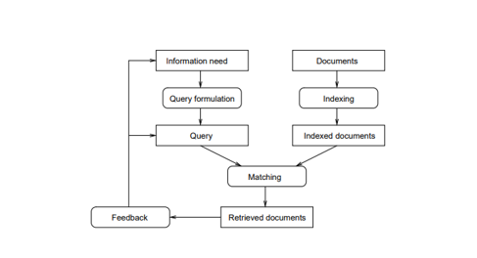
Process of Information Retrieval
There are three basic processes an information retrieval system has to support:
The representation of the content of the documents,
The representation of the user’s information need,and
The comparison of the two representations.

Slide 8
Types of Data
Depending on the application the data objects may be
text documents
Images
audio
videos
Often the documents themselves are not kept or stored directly in the IR system, but are instead represented in the system by document surrogates or metadata.

Slide 9
Document Surrogate
In systems with statistical ranking, a numerical score or percentage is also often shown alongside the title, where the score indicates a computed degree of match or probability of relevance.
This kind of information is sometimes referred to as a document surrogate.

Slide 10
Numeric Score in IR Systems
Most IR systems compute a numeric score on how well each object in the database matches the query, and rank the objects according to this value.
The top-ranking objects are then shown to the user.
The process may then be iterated if the user wishes to refine the query.

Slide 11
Need for IR Systems
The need for an IR system occurs when a collection reaches a size where traditional cataloguing techniques can no longer cope.
With the growth of digitised unstructured information and, via high speed networks, rapid global access to enormous quantities of that information, the only viable solution to finding relevant items from these large text databases was search, and IR systems became ubiquitous.

Slide 12
History Of Information Retrieval
The long history of information retrieval does not begin with the internet. It is only in the last decade and a half of the IEEE’s one hundred years that web search engines have become pervasive and search has become integrated into the fabric of desktop and mobile operating systems.
Prior to the broad public day-to-day use of search engines, IR systems were found in commercial and intelligence applications as long ago as the 1960s.
The earliest computer-based searching systems were built in the late 1940s and were inspired by pioneering innovation in the first half of the 20th century.

Slide 13
History Of Information Retrieval (Cont.)
As with many computer technologies, the capabilities of retrieval systems grew with increases in processor speed and storage capacity.
The number of bits of information packed into a square inch of hard drive surface grew from 2,000 bits in 1956 to 100 billion bits in 2005.
The development of such systems also reflects a rapid progression away from manual library-based approaches of acquiring, indexing, and searching information to increasingly automated methods.

Slide 14
Information Retrieval Models
An IR model governs
how documents are represented
How a query is represented
how the relevance of a document to a user query is defined.
Need for IR Models
There are two good reasons for having models of information retrieval.
The first is that models guide research and provide the means for academic discussion.
The second reason is that models can serve as a blueprint to implement an actual retrieval system.

Slide 15
Boolean Model
The Boolean model is the first model of information retrieval and probably also the most criticised model.
The model can be explained by thinking of a query term as an unambiguous definition of a set of documents.
For instance, the query term economic simply defines the set of all documents that are indexed with the term economic.
Using the Boolean operators (AND, OR, NOT), query terms and their corresponding sets of documents can be combined to form new sets of documents.

Slide 16
AND Operator
Combining terms with the AND operator will define a document set that is smaller than or equal to the document sets of any of the single terms.
For instance, the query social AND economic will produce the set of documents that are indexed both with the term social and the term economic.
So it produces intersection of two sets.

Slide 17
OR Operator
Combining terms with the OR operator will define a document set that is bigger than or equal to the document sets of any of the single terms.
So, the query social OR political will produce the set of documents that are indexed with either the term social or the term political, or both.
So it produces union of both sets.

Slide 18
OR Operator
Not operator will produce the compliment.
So, the query NOT (social OR political) will produce the set of documents that are neither indexed with the term social nor with the term political.

Slide 19
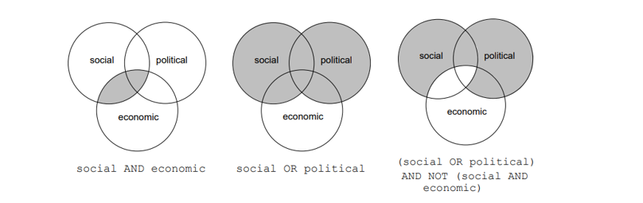
Visualization
This is visualised in the Venn diagrams of Figure 2 in which each set of documents is visualised by a disc.
The intersections of these discs and their complements divide the document collection into 8 nonoverlapping regions, the unions of which give 256 different Boolean combinations of ‘social, political and economic documents’

Slide 20
The Probabilistic Indexing Model
As early as 1960, Bill Maron and Larry Kuhns (Maron and Kuhns 1960) defined their probabilistic indexing model.
They did not target automatic indexing by information retrieval systems.
Manual indexing was still guiding the field, so they suggested that a human indexer, who runs through the various index terms T that possibly apply to a document D, assigns a probability P(T|D) to a term given a document instead of making a yes/no decision for each term.

Slide 21

The Probabilistic Indexing Model (Cont.)
So, every document ends up with a set of possible index terms, weighted by P(T|D), where P(T|D) is the probability that if a user wants information of the kind contained in document D, he/she will formulate a query by using T . Using Bayes’ rule, i.e.,
They then suggest to rank the documents by P(D|T ), that is, the probability that the document D is relevant given that the user formulated a query by using the term T.

Slide 22
Types of Queries in IR
Different keywords and other characterizations of documents are associated with the document set during the process of indexing.
They are used by an IR system to build an inverted index, which is then consulted during the search.
The queries formulated by users are compared to the set of index keywords.
The query language with these operators enriches the expressiveness of a user’s information need.
Some of the types of Queries in IR systems are –
Keyword Queries
Boolean Queries
Phrase Queries
Proximity Queries
Wildcard Queries
Natural Language Queries

Slide 23
Keyword Queries
Keyword-based queries are the simplest and most commonly used forms of IR queries: the user just enters keyword combinations to retrieve documents.
The query keyword terms are implicitly connected by a logical AND operator. A query such as ‘database concepts’ retrieves documents that contain both the words ‘database’ and ‘concepts’ at the top of the retrieved results.
Most IR systems do not pay attention to the ordering of these words in the query.
All retrieval models provide support for keyword queries.

Slide 24
Boolean Queries
Some IR systems allow using the AND, OR, NOT, (), +, and – Boolean operators in combinations of keyword formulations.
Complex Boolean queries can be built out of these operators and their combinations, and they are evaluated according to the classical rules of Boolean algebra.
No ranking is possible, because a document either satisfies such a query (is “relevant”) or does not satisfy it (is “nonrelevant”).
Users generally do not use combinations of these complex Boolean operators, and IR systems support a restricted version of these set operators.

Slide 25
Phrase Queries
A phrase query consists of a sequence of words that makes up a phrase, generally enclosed within double quotes.
Each retrieved document must contain at least one instance of the exact phrase.
Phrase searching is a more restricted. For example, a phrase searching query could be ‘conceptual database design’.
A phrase thesaurus may also be used in semantic models for fast dictionary searching for phrases.

Slide 26
Proximity Queries
Proximity search refers to a search that accounts for how close within a record multiple terms should be to each other.
The most commonly used proximity search option is a phrase search that requires terms to be in the exact order.
Other proximity operators can specify how close terms should be to each other. Some will also specify the order of the search terms.
Vector space models that also maintain information about positions and offsets of tokens (words) have robust implementations for this query type.
It requires the time-consuming preprocessing of documents, and is thus suitable for smaller document collections rather than for the Web.

Slide 27
Wildcard Queries
Wildcard searching is generally meant to support regular expressions and pattern matching-based searching in text.
In IR systems, certain kinds of wildcard search support may be implemented—usually words with any trailing characters (for example, ‘data*’ would retrieve data, database, datapoint, dataset, and so on).
Providing support for wildcard searches in IR systems involves preprocessing overhead and is not considered worth the cost by many Web search engines today.
Retrieval models do not directly provide support for this query type.

Slide 28
Natural Language Queries
There are a few natural language search engines that aim to understand the structure and meaning of queries written in natural language text, generally as a question or narrative.
Some search systems are starting to provide natural language interfaces to provide answers to specific types of questions, such as definition and factoid questions, which ask for definitions of technical terms or common facts that can be retrieved from specialized databases.
Such questions are usually easier to answer because there are strong linguistic patterns giving clues to specific types of sentences—for example, ‘defined as’ or ‘refers to’.

Slide 29
Text Preprocessing
To preprocess your text simply means to bring your text into a form that is analyzable for your task.
In this section we review the commonly used text preprocessing techniques that are part of the text processing task.
Some of text preprocessing techniques that are used, are given below:
Stopword Removal
Stemming
Utilizing a thesaurus
The details of these techniques are given in next slides.

Slide 30
Stopword Removal
Stopwords are very commonly used words in a language that play a major role in the formation of a sentence but which seldom contribute to the meaning of that sentence.
Words that are expected to occur in 80 percent or more of the documents.
Examples include words such as the, of, to, a, and, in, said, for etc.
Removal of stopwords results in elimination of possible spurious indexes, thereby reducing the size of an index.
However, doing so could impact the recall if the stopword is an integral part of a query.
Many search engines do not employ query stopword removal for this reason.

Slide 31
Stemming
A stem of a word is defined as the word obtained after trimming the suffix and prefix of an original word.
For example, ‘comput’ is the stem word for computer, computing, and computation.
A stemming algorithm can be applied to reduce any word to its stem.
the most famous stemming algorithm ➔ Martin Porter’s stemming algorithm.
Using stemming for preprocessing data results in a decrease in the size of the indexing structure.

Slide 32
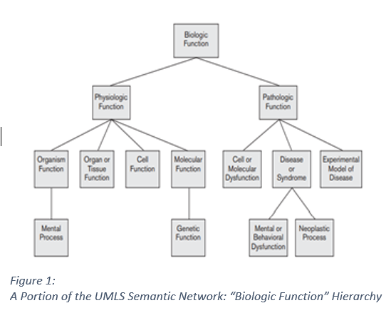
Utilizing a Thesaurus
A thesaurus comprises a precompiled list of important concepts and the main word that describes each concept for a particular domain of knowledge.
For each concept in this list, a set of synonyms and related words is also compiled.
This preprocessing step assists in providing a standard vocabulary for indexing and searching.
Usage of a thesaurus has a substantial impact on the recall of information systems.
UMLS20 is a large biomedical thesaurus of millions of concepts (called the Metathesaurus.

Slide 33
Information Extraction (IE)
Information extraction (IE) is a generic term used for extracting structured content from text.
Text analytic tasks such as identifying noun phrases, facts, events, people, places, and relationships are examples of IE tasks.
These tasks are also called named entity recognition.
For IR and search applications, IE technologies are mostly used to identify contextually relevant features that involve text analysis, matching, and categorization for improving the relevance of search systems.

Slide 34
Inverted Indexing
The simplest way to search for occurrences of query terms in text collections can be performed by sequentially scanning the text.
Most information retrieval systems process the text collections to create indexes and operate upon the inverted index data structure.
An inverted index structure comprises vocabulary and document information.
Weights are assigned to document terms to represent an estimate of the usefulness of the given term as a descriptor for distinguishing the given document from other documents in the same collection.

Slide 35
Inverted Indexing (Cont.)
An inverted index of a document collection is a data structure that attaches distinct terms with a list of all documents that contains the term.
The different steps involved in inverted index construction can be summarized as follows:
Break the documents into vocabulary terms by tokenizing, cleansing, stopword removal, stemming, and/or use of an additional thesaurus as vocabulary.
Collect document statistics and store the statistics in a document lookup table.
Invert the document-term stream into a term-document stream along with additional information such as term frequencies, term positions, and term weights.

Slide 36
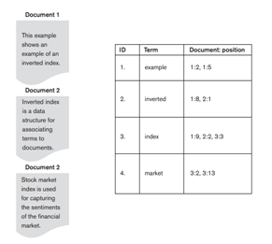
Inverted Indexing
An illustration of term-document-position vectors for the four illustrative terms—example, inverted, index, and market—which refer to the three documents and the position where they occur in those documents.

Slide 37
Inverted Indexing (Cont.)
Searching for relevant documents from the inverted index, given a set of query terms, is generally a three-step process.
Vocabulary search
Document information retrieval
Manipulation of retrieved information

Slide 38
Databases & IR Systems: A Comparison
Database System | IR Systems
Structured data | Unstructured data
Schema driven | No fixed schema; various data models
Structured query model | Free-form query models
Rich metadata operations | Rich data operations
Query returns data | Search request returns list or pointers to documents
Results are based on exact matching | Results are based on approximate matching and measures of effectiveness

Slide 39
Web Search
Finding desirable information over the web.
The emergence of the Web has brought millions of users to search for information, which is stored in a very large number of active sites.
Update their indexes given the dynamic nature of the Web as new Web sites are created.
Search engines have to apply many sophisticated techniques to efficiently retrieve data.

Slide 40
Web Search Architecture
For timely deliverance of information, web search engines are based on particular architectures. We can distinguish three architectures for Web searching:
Traditional (or centralized)
Metasearch
Distributed search

Slide 41
Centralized Architecture
The goal of general-purpose search engines is to index a sizeable portion of the Web
Crawler browses the Web
Collects documents by recursively fetching links to retrieve information from a set of start pages
The indexer processes the pages collected by the crawler
Might discard duplicate documents then, it builds various auxiliary data structures.

Slide 42
Meta-Search Architecture
Provide access to the information in the hidden Web’s text databases
Can be used to query multiple databases simultaneously
It performs three main tasks
Database selection
Query translation
Result merging

Slide 43
Distributed Search Architecture
Distributed heterogeneous search environments are an emerging phenomenon in Web search.
The original Internet was designed to be a peer-to-peer (P2P) system
Most major Web search engines are currently based on cluster architectures.
Partitioning and combining the rankings
The decentralized crawler manages to compute document rankings
A federation of independently controlled meta-searchers along with many specialized search engines

Slide 44
Web Search and its relationship with IR
Evaluation techniques of IR systems measure the topical relevance and user relevance.
User relevance is a term used to describe the “goodness” of a retrieved result with regard to the user’s information need.
User relevance includes other implicit factors, such as user perception, user’s environment, and current task needs.
Topical relevance measures the extent to which the topic of a result matches the topic of the query
Many users are not able to effectively form queries that would retrieve results more suited to their information need
There is no fixed set of right answers to show to the user

Slide 45
Web Page Importance
We must measure a page’s importance in order to rank it
Three approaches help with this process
link
content
anchor
In terms of IR, these measures reflect a model of Web documents

Slide 46
Web Page Importance (Cont.)
Link-based technique is a variant of the PageRank algorithm
It is used in Google search Engine
Tries to infer a Web page’s importance from just the topological structure of a directed graph associated with the Web
A page’s rank depends on the ranks of all the pages pointing to it
Page Ranking of a page depends not only on the number of pages pointing to it, but also on their importance

Slide 47
Web Page Importance (Cont.)
HITS is acronym of Hypertext Induced Topic Search
is used at query time and processed on a small subset of relevant documents
It computes two scores per document
Authoritative pages relevant to the initial query have large in-degree
Hub pages have links to multiple relevant authoritative pages
If a page were a good authority, many hubs would point to it
In the content-based approach, we compute the similarity score between a page and a predefined topic

Slide 48
Web Page Importance(Cont.)
Anchor text is the visible hyperlinked text on the Web page
Page quality can be judged by pattern matching between the query vector and the URL’s anchor text
Pros
The usual content-based approach ignores links and is susceptible to spam, and the link-based approach is not adequate for pages with low in-degree

Slide 49
Web Search Engines
Search engines are answer machines
Order to show up in search results, your content needs to first be visible to search engines
If your site can't be found, there's no way you'll ever show up in the Search Engine Results Page
Search engines have three primary functions:
Crawl
Index
Rank

Slide 50
Thank You

